Slide 1
Homework INSYS Icecream

Slide 2
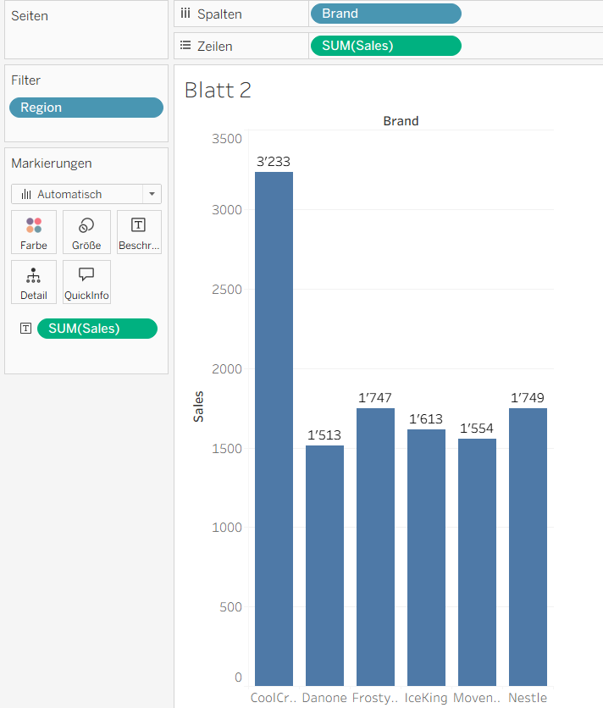
Q1:Who dominates the swiss Ice Cream market?
Cool Cream has the most Sales

Slide 3
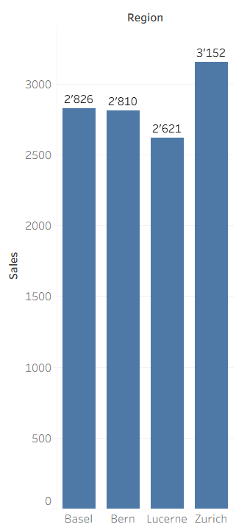
Which city consumes the most ice cream?
Zürich by the sum of sales

Slide 4
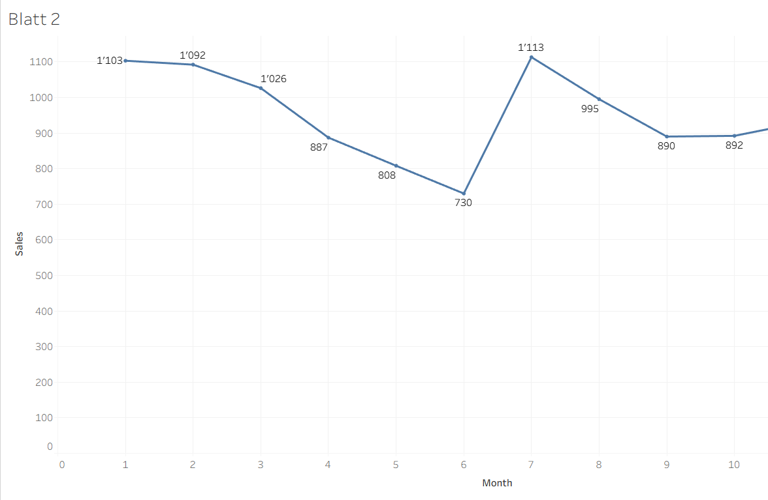
What is the best month of ice cream sales?
July

Slide 5
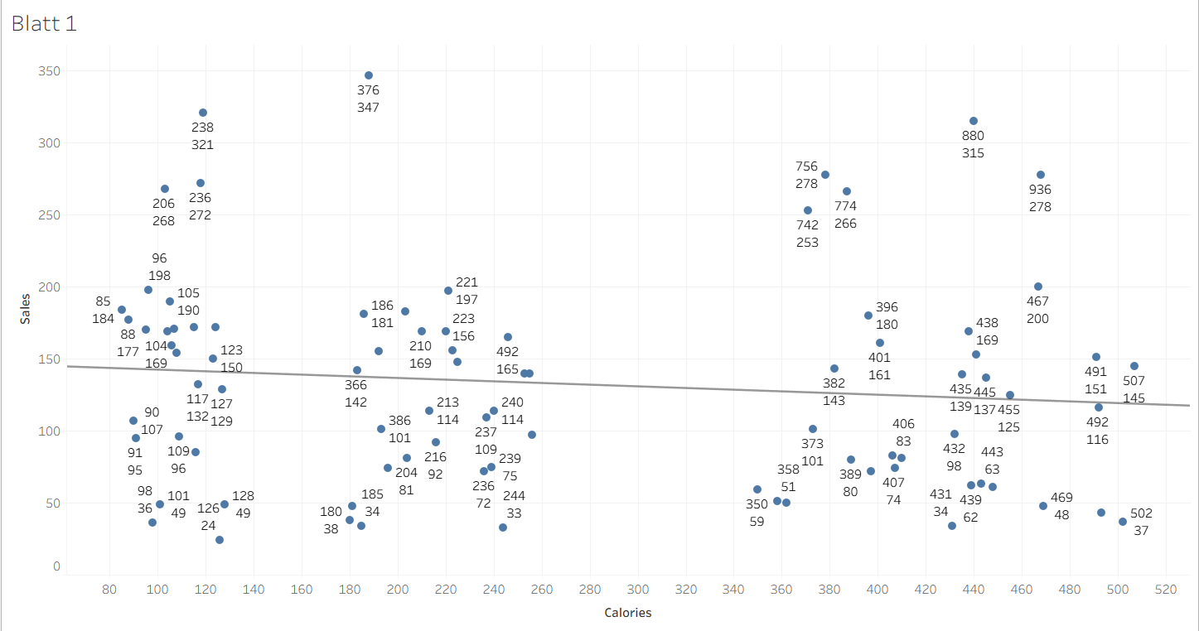
Do people prefer ice cream with higher calories?
Because of the trandline and it is decreasing you could say thats not the case

